Slide 1
Modeling Blood flow
By Michelle Tieu

Slide 2
Road map
Honors Project: Basic modeling of blood flow in a constricted blood vessel
Background
History
Relevance to health
Basic derivations of equations
Modeling
Brief Comparison

Slide 3
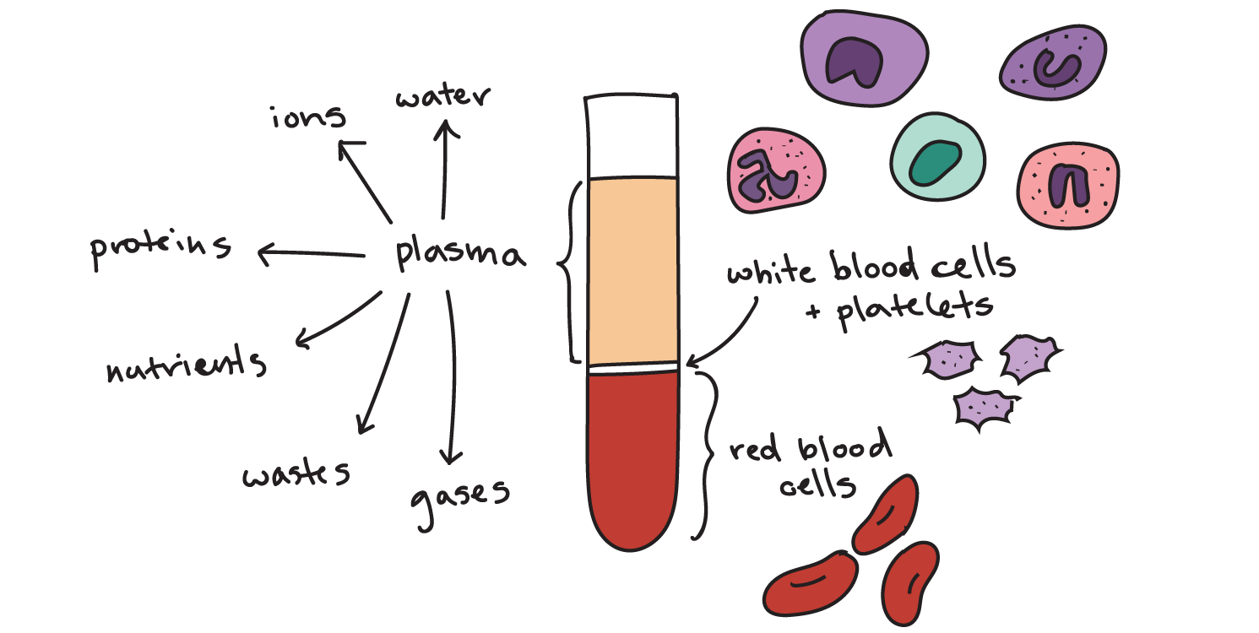
Intro
Blood plays a vital role in homeostasis
Transports oxygen throughout body
Transports nutrients and cellular wastes
Regulates temperature
Clotting

Slide 4
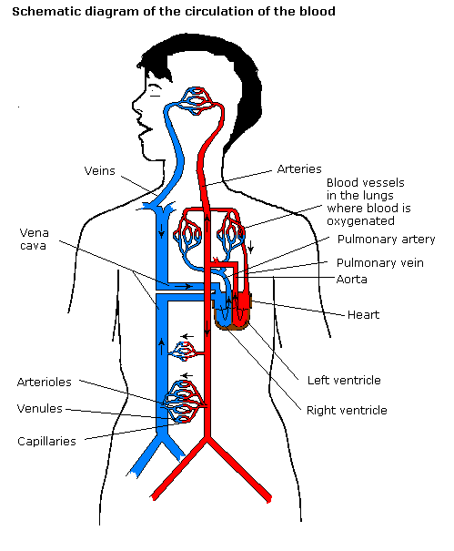
Circulatory System
Travels through the circulatory system
Heart → Arteries → Arterioles → Capillaries → Venules → Veins → Heart
Arteries move blood away from heart
Veins move blood towards heart
Capillaries allow for gas and nutrient exchange to occur

Slide 5
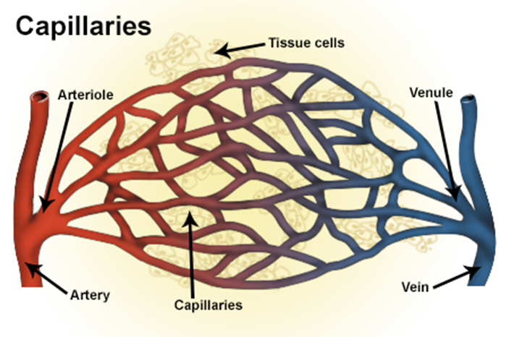
Circulatory System
Cross sectional area of arteries = 40 ${cm}^{2}$
Cross sectional area of capillaries = 6000 ${cm}^{2}$
Leads to decrease in pressure as blood travels through body
Elasticity in arteries
Localized blood volume increases after each heartbeat
More stable pressure is maintained

Slide 6
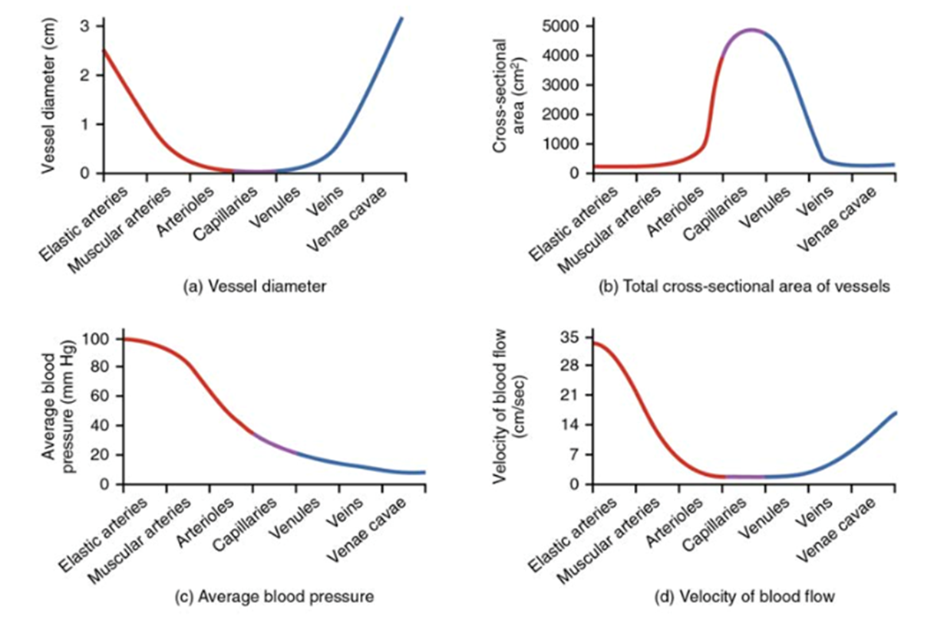
Blood Physics
Viscosity: property of fluids related to internal friction caused by layers moving past each other
Blood viscosity
Interactions between red blood cells
Temperature
Hydration

Slide 7
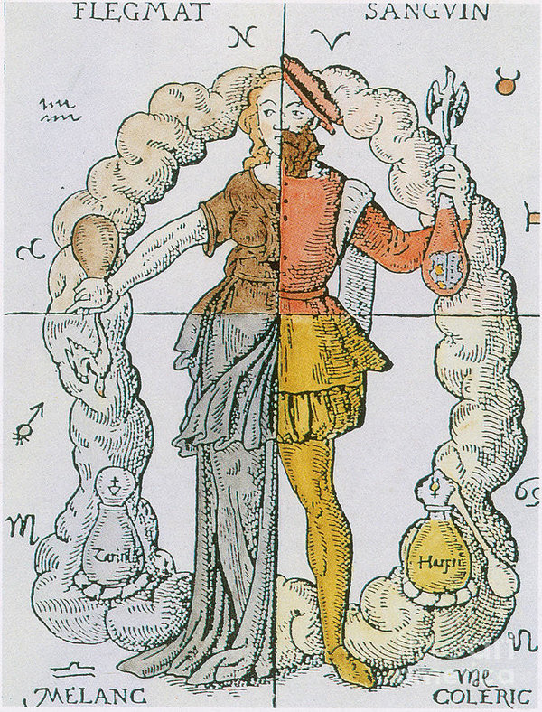
History in Medicine
Bloodletting was a common procedure
Hippocrates thought illness was due to an imbalance in the humors
Continued despite increased knowledge of the human body
George Washington died from this procedure
Currently used to treat hemochromatosis
Used to test for diseases

Slide 8
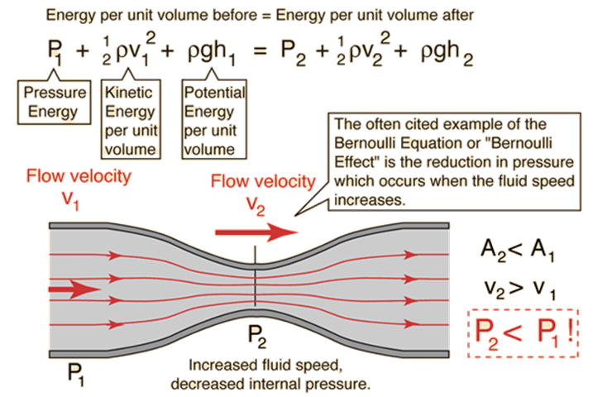
History in Modeling
Archimedes (285-212 B.C.)
Pressure change can cause water to move against gravity
Leonardo da Vinci (1452-1519)
Conservation of mass is 1-D steady flow
Isaac Newton (1642-1727)
Defined what a Newtonian fluid is
Mathematical Principles of Natural Philosophy published in 1687
Daniel Bernoulli (1700-1782)
Explained inverse relationship between pressure and velocity when a streamline is decreased
Jean-Louis-Marie Poiseuille (1799-1869)
Took friction into account

Slide 9
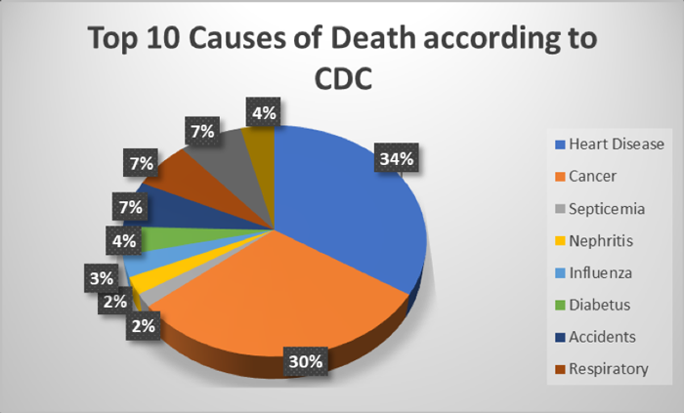
Relevance
Accumulation of plaque in arteries is one of the most common issues that people face as they age
Heart has to compensate by beating faster
In the U.S., 30% of the adult population has
hypertension (high blood pressure) →
Coronary artery disease
Heart failure
Aneurism
Eye blood vessel damage
Enlarged left heart
Nerve damage
Kidney failure

Slide 10
Equations
Conservation of Mass
Assuming that blood is incompressible:
can be derived to
Conservation of Momentum
Assumptions:
because flow is steady
because only small changes in gravitational potential energy occur
Viscous forces are negligible
ρ is constant

Slide 11
Equations
Conservation of Momentum cont.
→
Newton’s second law can be applied to conservation of momentum →
By considering the assumptions, Bernoulli’s equation can be simplified from these equations

Slide 12
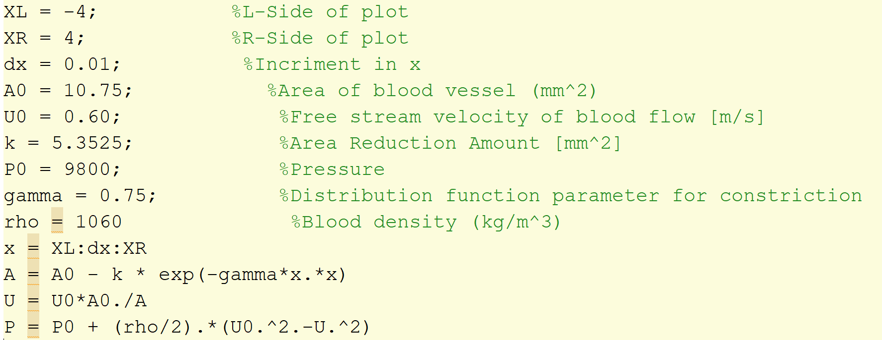
Modeling
Quasi 1-D because model is based on cross sectional area
Chose to model 55% area reduction
Normal distribution

Slide 13
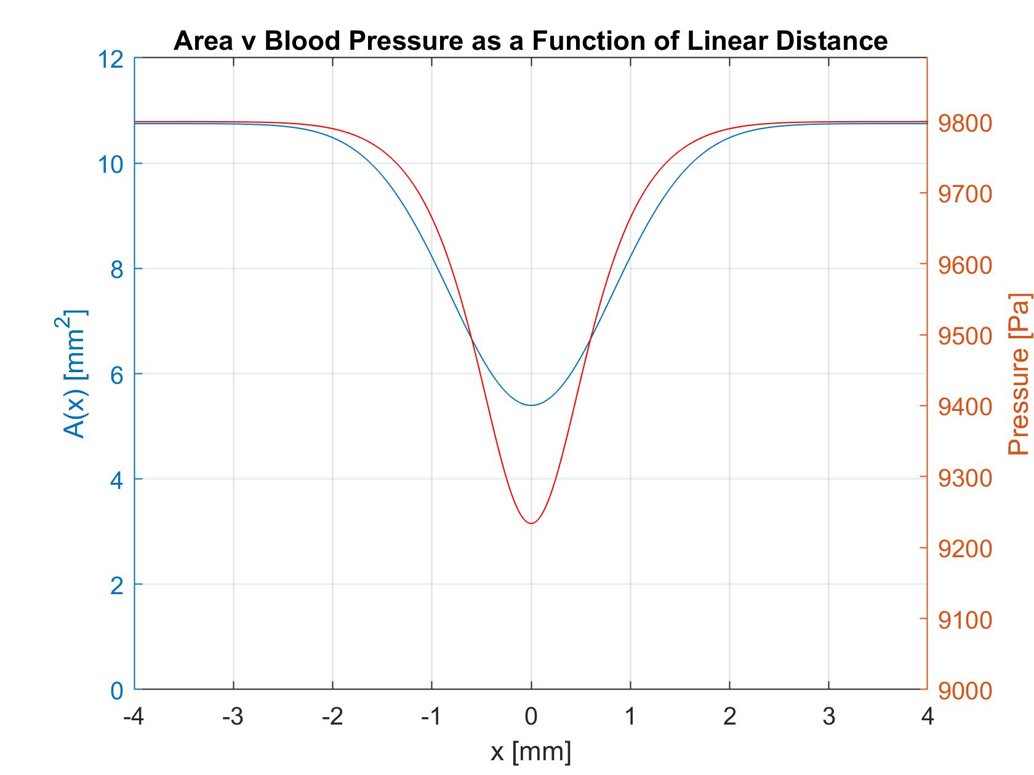
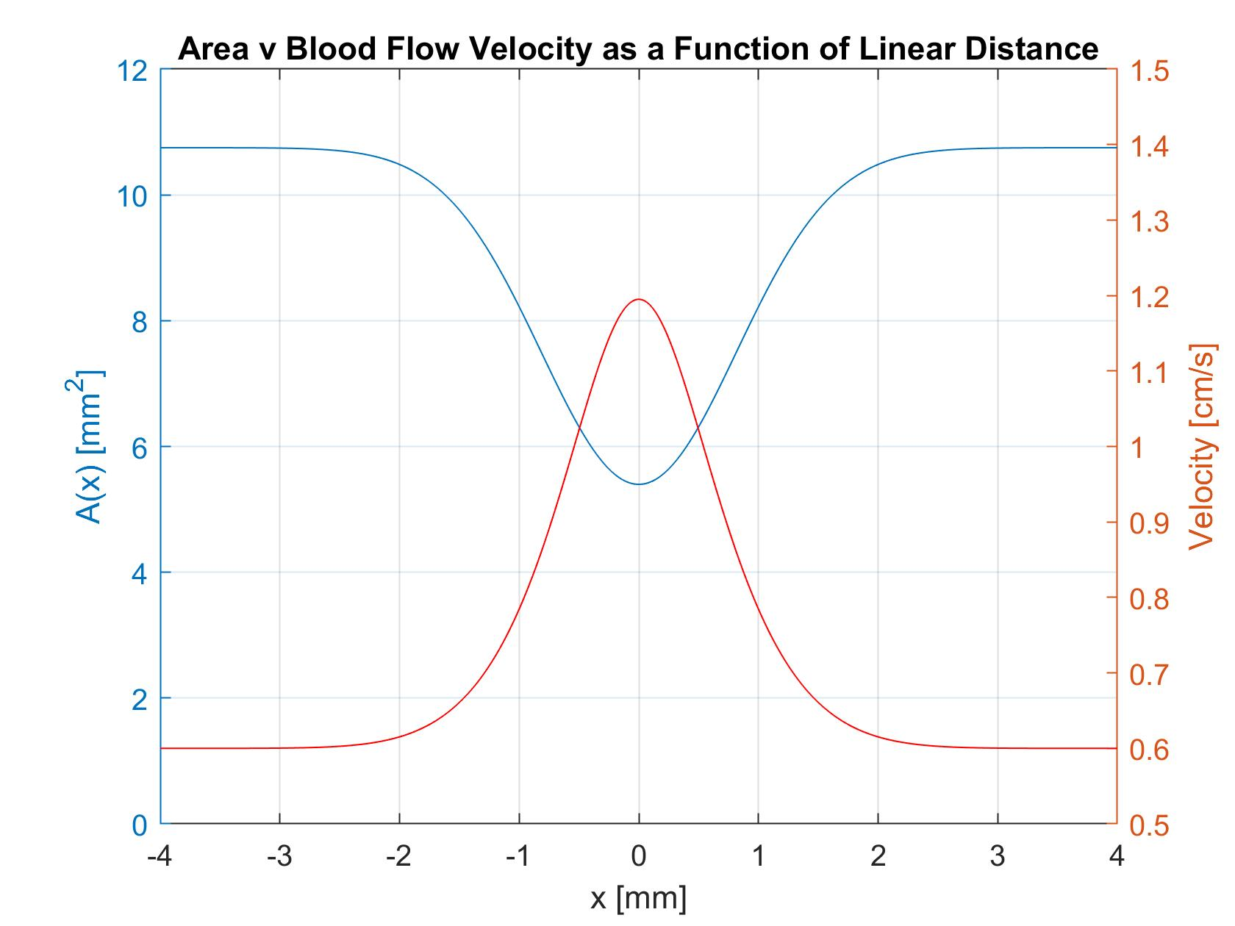
Modeling

Slide 14
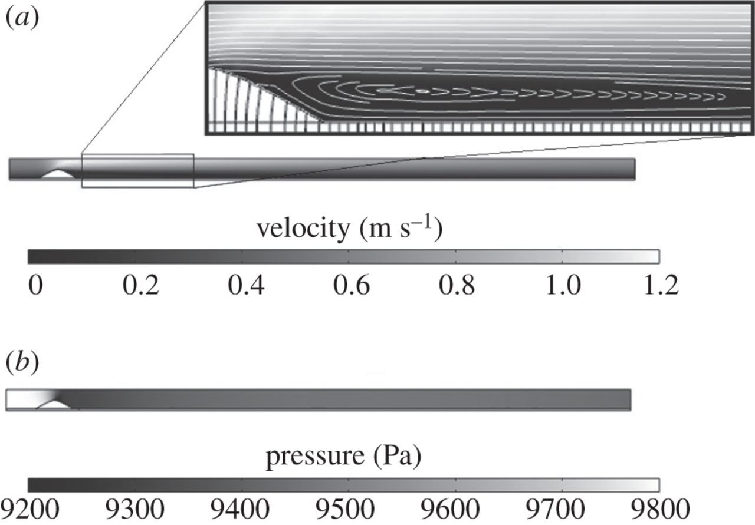
MOdeling

Slide 15
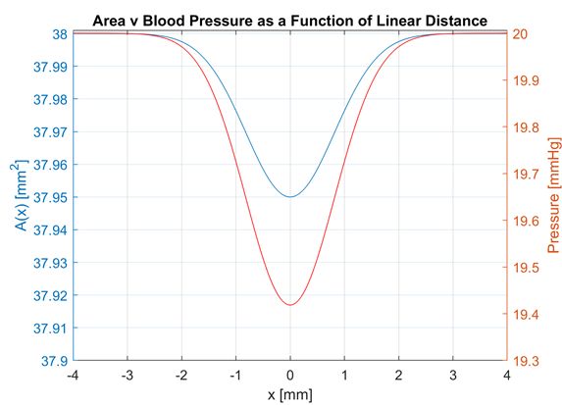
Comparison
Notes:
Because it takes into account turbulence and they use the navier-stokes equation

Slide 16
Final Remarks
Bernoulli’s Equation is insufficient
Only takes a few variables into account
Future:
Viscosity
Turbulence
Pulsing caused by a heartbeat

Slide 17
Works Cited
“Anatomy & Physiology.” SEER Training:Anatomical Terminology, training.seer.cancer.gov/anatomy/.
“Bernoulli Equation.” Total Internal Reflection, hyperphysics.phy-astr.gsu.edu/hbase/pber.html.
“Bernoulli's Equation.” Princeton University, The Trustees of Princeton University, www.princeton.edu/~asmits/Bicycle_web/Bernoulli.html.
“Complications of Diabetes.” Government of Western Australia: Department of Health, www.healthywa.wa.gov.au/Articles/A_E/Complications-of-diabetes.
“Fluids.” MIT, 2016, web.mit.edu/16.unified/www/FALL/fluids/Lectures/f13.pdf.
“High Blood Pressure Fact Sheet|Data & Statistics|DHDSP|CDC.” Centers for Disease Control and Prevention, Centers for Disease Control and Prevention, www.cdc.gov/dhdsp/data_statistics/fact_sheets/fs_bloodpressure.htm.
“How High Blood Pressure Can Affect Your Body.” Mayo Clinic, Mayo Foundation for Medical Education and Research, 9 Jan. 2019, www.mayoclinic.org/diseases-conditions/high-blood-pressure/in-depth/high-blood-pressure/art-20045868.
“Humans and History; the Discovery of Blood. Timeline.” Timetoast, www.timetoast.com/timelines/eminent-cairo-is-a-physician-he-is-the-one-who-discovered-the-flow-of-blood-that-goes-to-and-from-the-lungs-also-known-as-pulmonary-circulation.
“Isaac Newton.” Biography.com, A&E Networks Television, 14 Feb. 2019, www.biography.com/people/isaac-newton-9422656.
“Poiseuille's Law: A Historical Background.” Pressure and Blood Flow, archive.math.arizona.edu/maw1999/blood/poiseuille/history.htm.
“Smoking and Cardiovascular Disease.” Centers for Disease Control and Prevention, www.cdc.gov/tobacco/data_statistics/sgr/50th-anniversary/pdfs/fs_smoking_CVD_508.pdf.
Cohen, Jennie. “A Brief History of Bloodletting.” History.com, A&E Television Networks, 30 May 2012, www.history.com/news/a-brief-history-of-bloodletting.
Dellinger, Guilhem. “Computational Fluid Dynamics Modeling for the Design of Archimedes Screw Generator.” NeuroImage, Academic Press, 17 Nov. 2017, www.sciencedirect.com/science/article/pii/S0960148117310613.

Slide 18
Works Cited
Greenestone, Gerry. “The History of Bloodletting. BCMJ, Vol. 52, No. 1, January, February, 2010, Page(s) 12-14 - Premise.” British Colombia Medical Journal, Jan. 2010, www.bcmj.org/premise/history-bloodletting.
Groopman, Jerome. “The History of Blood.” The New Yorker, The New Yorker, 7 Jan. 2019, www.newyorker.com/magazine/2019/01/14/the-history-of-blood.
Hoffman, J I, and J A Spaan. “Pressure-Flow Relations in Coronary Circulation.” Physiological Reviews, U.S. National Library of Medicine, Apr. 1990, www.ncbi.nlm.nih.gov/pubmed/2181499.
Klabunde, Richard. “Viscosity of Blood.” Image for Cardiovascular Physiology Concepts, Richard E Klabunde PhD, www.cvphysiology.com/Hemodynamics/H011.
Kramer, Samantha. “Aztec Human Sacrifice.” Rise of Civilization, 25 Apr. 2013, anthropology.msu.edu/anp264-ss13/2013/04/25/aztec-human-sacrifice/.
Mada'a, Patrik, and Josef Fontana. “Composition of Blood and Its Functions.” Functions of Cells and Human Body, University Development Fund, fblt.cz/en/skripta/v-krev-a-organy-imunitniho-systemu/1-slozeni-krve/.
Majdalani, Joseph. Brief History of Fluid Mechanics . majdalani.eng.auburn.edu/courses/02_fluids/handout_f01_history.pdf.
OpenStax. “Anatomy and Physiology.” Introduction to Sociology – 1st Canadian Edition, BCcampus, 6 Mar. 2013, opentextbc.ca/anatomyandphysiology/front-matter/preface-2/.
OpenStax. “Homeostasis.” Introduction to Sociology – 1st Canadian Edition, BCcampus, 6 Mar. 2013, opentextbc.ca/anatomyandphysiology/chapter/1-5-homeostasis/.
Quinney, D.A. “Daniel Bernoulli and the Making of the Fluid Equation.” The Mathematics of Diseases, 25 July 2018, plus.maths.org/content/daniel-bernoulli-and-making-fluid-equation.
Rahman, Shoaibur. “Mathematical Modeling of Blood Flow.” An Introduction to Biometric Recognition - IEEE Journals & Magazine, Wiley-IEEE Press, 2012, ieeexplore.ieee.org/document/6317446.
Sherwood, Lauralee. “Human Physiology: From Cells to Systems.” Bionumbers, Wadsworth Publishing Company, 1997, bionumbers.hms.harvard.edu/bionumber.aspx?id=110559.
Sutera, Salvator, and Richard Skalak. “The History of Poiseuille's Law.” Washington.edu, 1993, depts.washington.edu/jrphys/ph115S13/Pois.pdf.
T. Doi, et al. . Aviation, Space, and Environmental Medicine, 75, 6 (2004) 500-504.

