Slide 1
Rocketry and Differential Equations
Colton Acosta
4/14/19

Slide 2
Objectives
History of Rocketry
Pre-Apollo 11 Missions
Description of Apollo 11
Modeling of Apollo 11

Slide 3
Introduction
The mathematics of Differential Equations and Numerical methods is extremely important for modeling rockets
This presentation will briefly go over the history of rocketry and use differential equations to predict and compare velocities of the Apollo 11 lunar mission

Slide 4
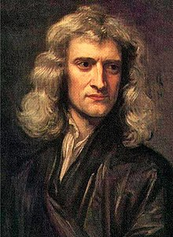
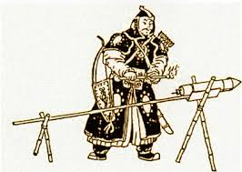
Early History of Rocketry
first used by the Chinese in the 13th century
used gunpowder as propellant
crude version of a solid propellant motor
Mathematics necessary for more sophisticated rockets was derived in the 1600s

Slide 5
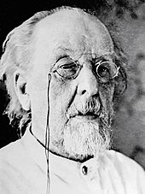
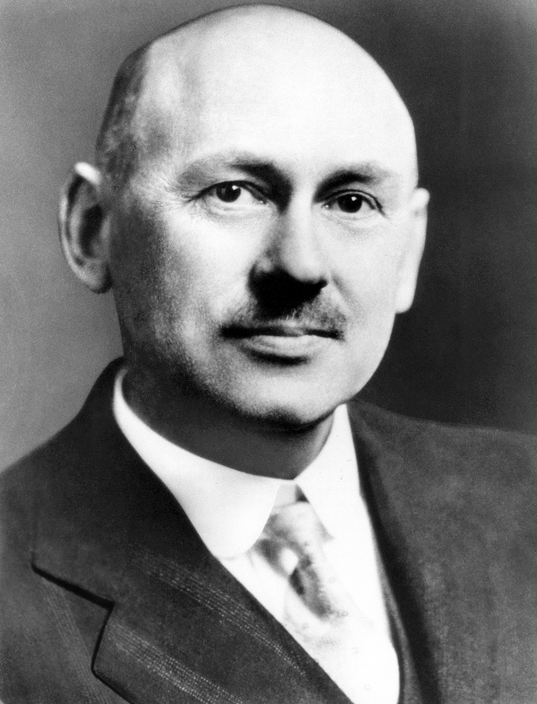
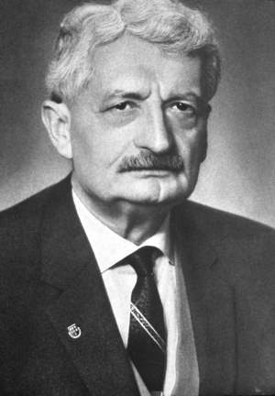
Fathers of Astronautics
At the turn of the 20th century rocketry was considered as a means for space travel
Astronautics developed independently in the U.S, Germany, and Russia.
The men responsible share the title “Father of Astronautics”
Tsiolkovsky
Goddard
Oberth

Slide 6
Konstantin Tsiolkovsky
Theoretical Scientist
Derived the Rocket Equation and developed a theory of multi-stage rockets
Interested in Liquid Propellant Rocket Engines
Rocket Equation:

Slide 7
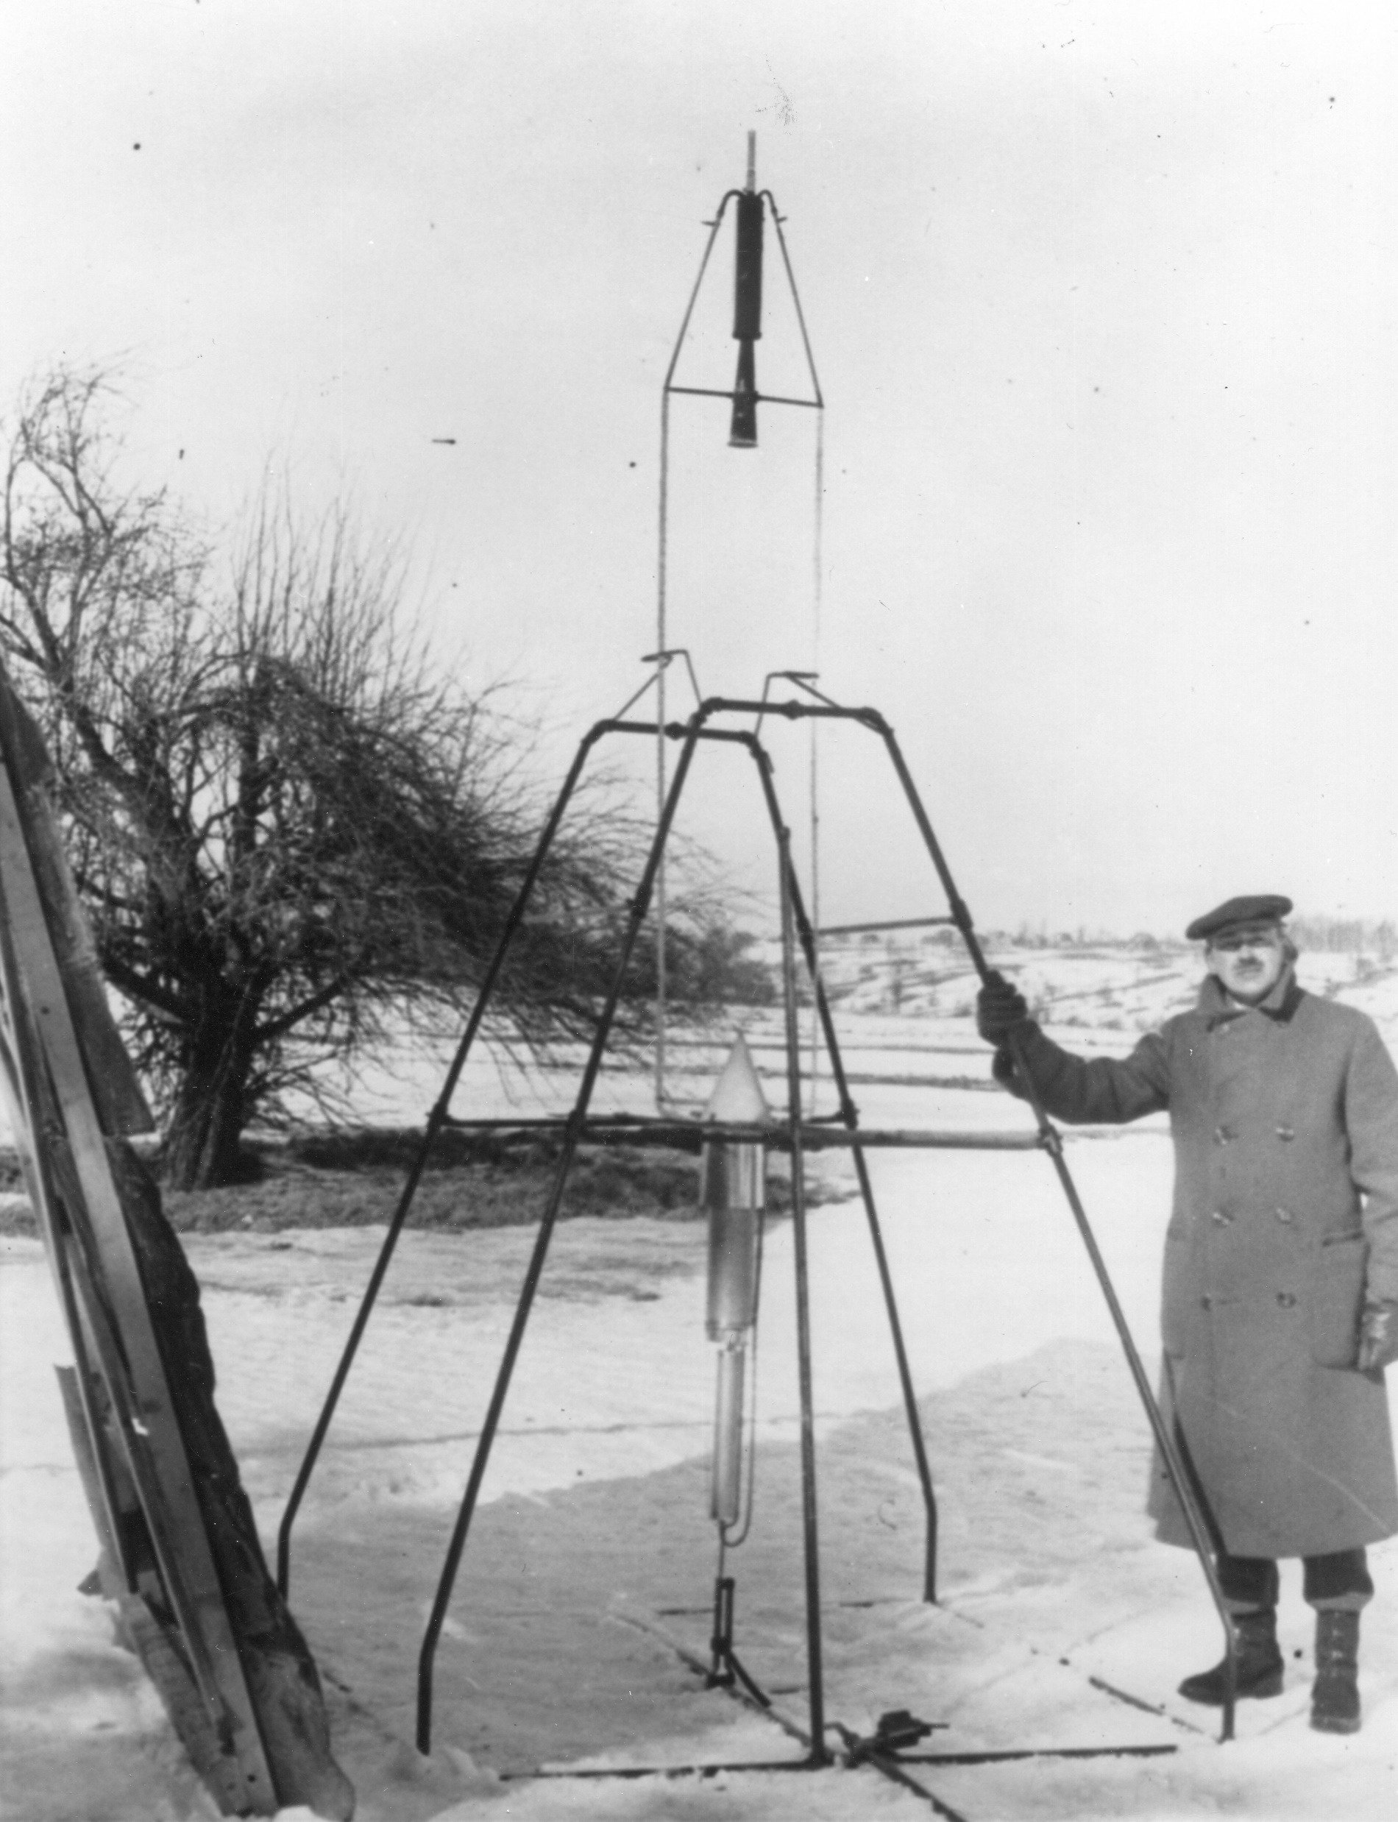
Robert Goddard
Launched the first liquid propellant rocket in Auburn Massachusetts in 1926.
fueled by liquid Oxygen and Gasoline
foundation for the German V-2 rocket (Gyroscopic Control, Gimbal Steering)

Slide 8
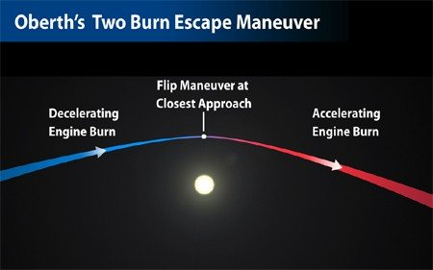
Hermann Oberth
Built Germany’s first liquid propellant rocket in 1931
Oberth Maneuver
Drew public interest in rocketry
lead to the establishment of the Nazi Rocketry program,

Slide 9
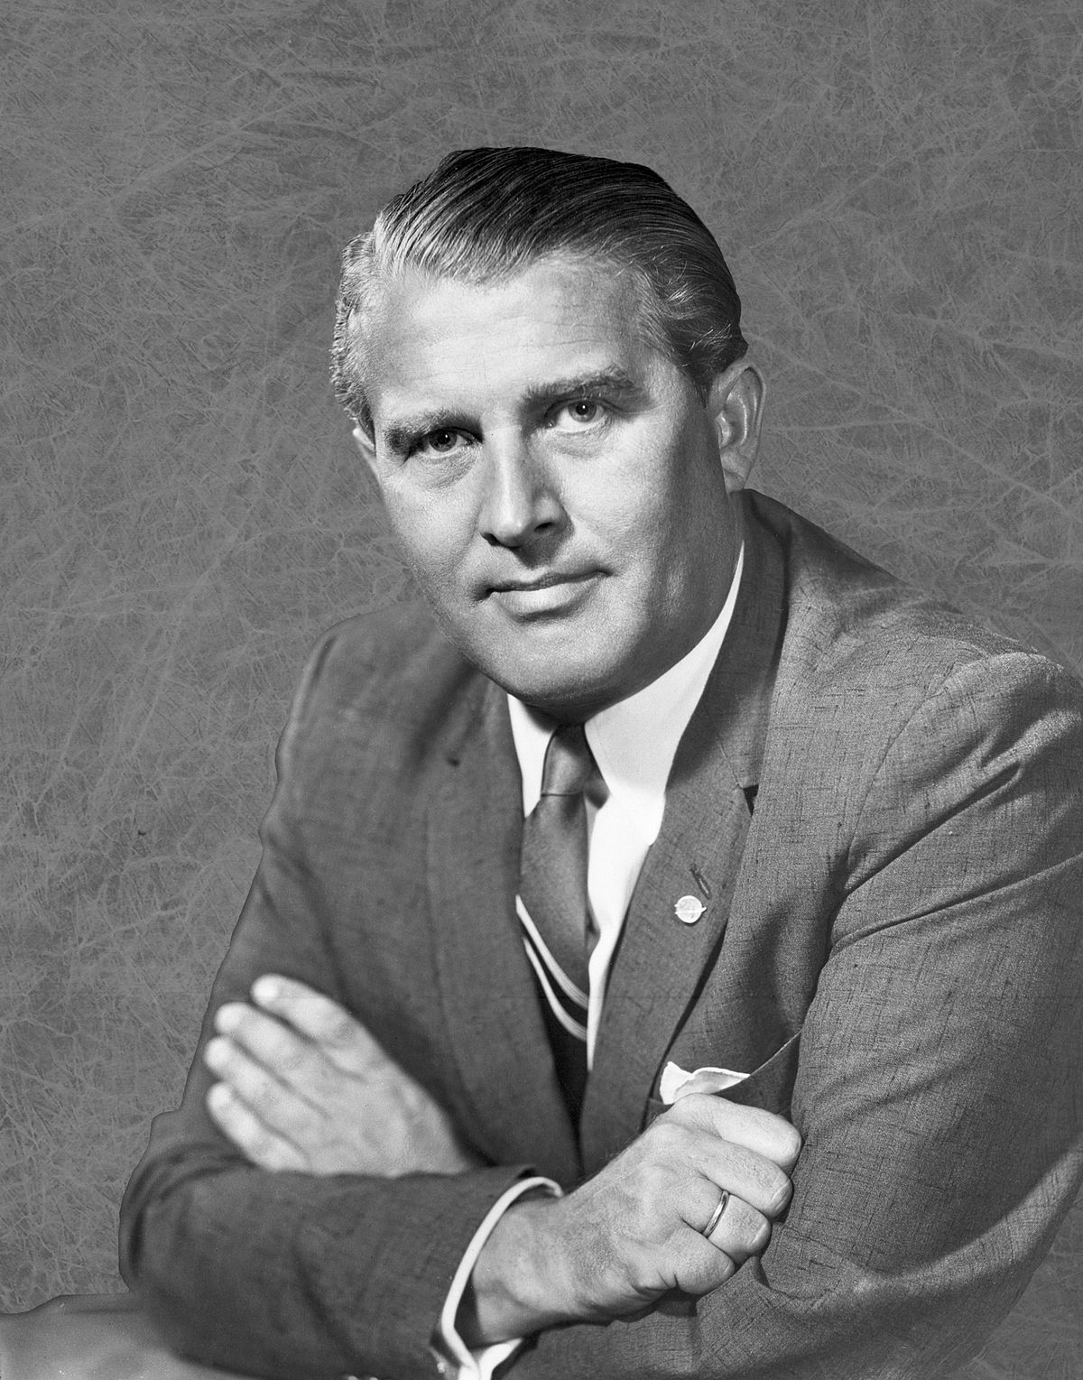
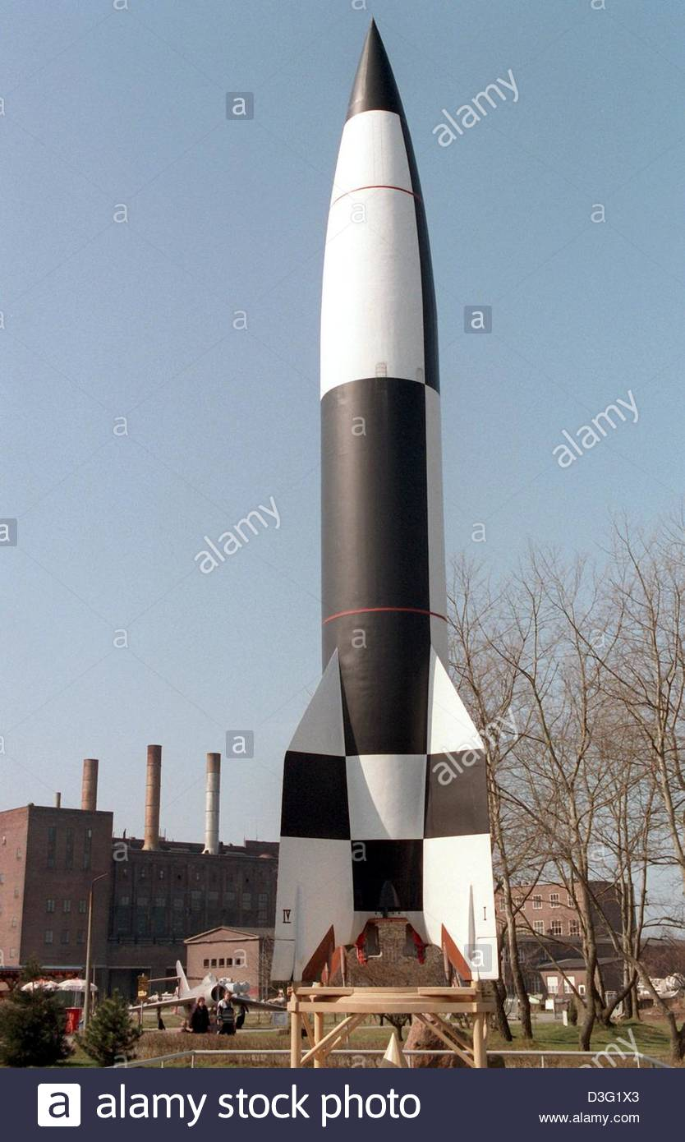
Rocketry and WWII
Von Braun
Werner Von Braun head of Nazi rocketry program
The V-2 Rocket, first used in 1944
Operation Paperclip, Nazi Scientists come to the U.s.
U.S. worked on V-2 rocketry to develop missiles capable of carrying a nuclear warhead
V-2

Slide 10
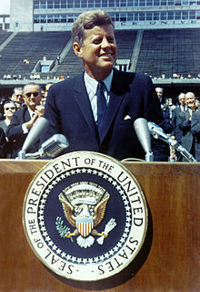
Establishment of NASA
In 1960 Eisenhower established NASA
Von Braun was appointed to head the Saturn V moon project
1961 JFK speech “We Choose to Go to the Moon” gained public support and secured NASA funding

Slide 11
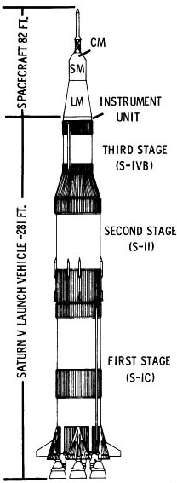
Saturn V
363 feet tall
Three stages
F-1 and J-2 liquid propellant engines
First stage powered by 5 F-1s, 7.5 million pounds of thrust
Liquid Oxygen Oxidizer and Kerosene fuel
Second Stage powered by 5 J-2s, 1.1 million pounds of thrust
Liquid Oxygen and Hydrogen
Third Stage powered by 1 J-2

Slide 12
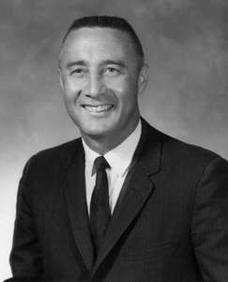
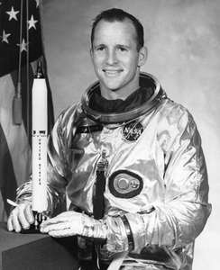
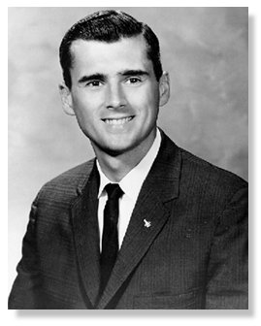
Apollo 1
Tragedy during Pre-Flight test for first Manned Apollo mission
Astronauts Virgil Grissom, Edward White, and Roger Chaffe die in a fire that swept through the Command Module
Virgil Grissom
Edward White
Roger Chaffe

Slide 13
Leading Up to Apollo 11
Mission | Objective
Apollo 4 | Unmanned Saturn V test flight, Heat shield test
Apollo 5 | Lunar Module test flight
Apollo 6 | Second Flight of Saturn V
Apollo 7 | Test space broadcasting capabilities
Apollo 8 | Demonstrate Translunar Injection, Apollo spacecraft navigation capabilities
Apollo 9 | Demonstrate self-sufficiency of Apollo spacecraft
Apollo 10 | Carry out unmanned Apollo 11 mission

Slide 14
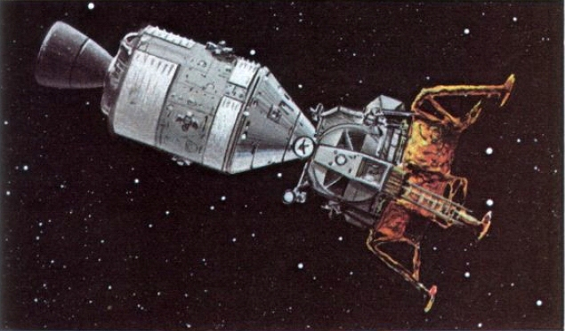
Apollo 11 Spacecraft
Self-sufficient spacecraft for the lunar mission
Consists of Command Module (CM), Service Module (SM), and a Lunar Module (LM)
Service Module makes trajectory corrections
Lunar Module descends to the Lunar Surface
Command Module returns to Earth

Slide 15
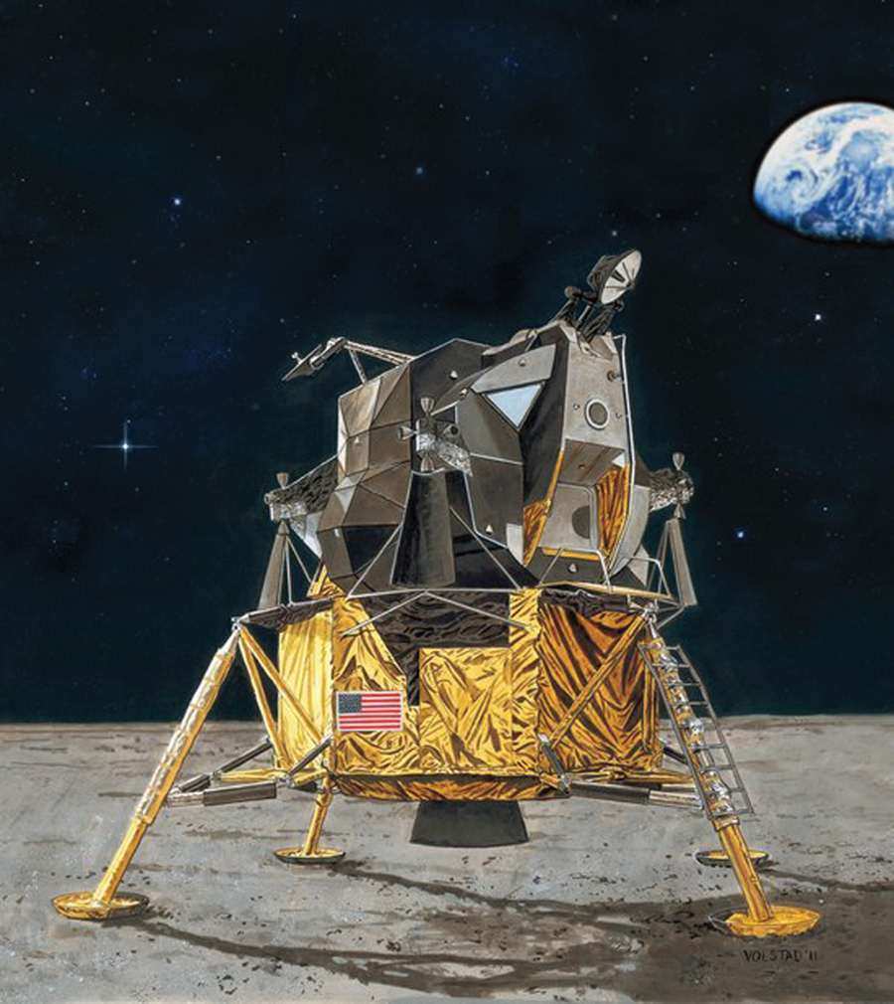
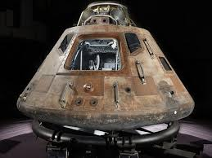
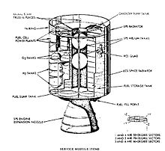
Apollo 11 Spacecraft
Lunar Module
Command Module
Service Module

Slide 16
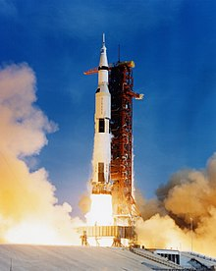
Apollo 11 Mission Part 1: Launch to Lunar Insertion
Apollo 11 launches, first and second stage fuel is entirely used up and jettisoned
Third stage burns and puts spacecraft in low earth orbit
Third stage burns again and sends spacecraft on translunar trajectory
Docking procedure
Third stage is jettisoned

Slide 17
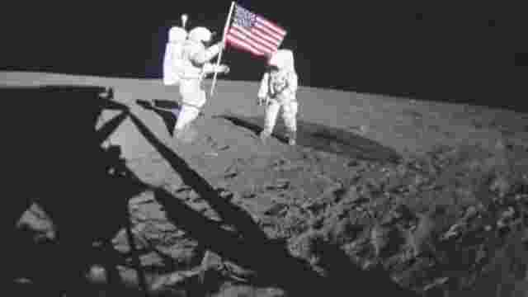
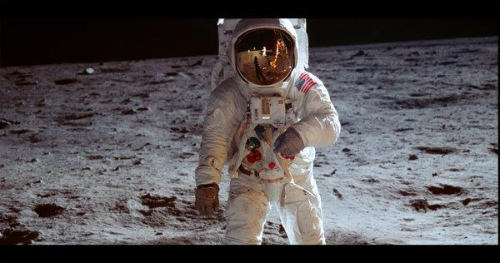
Apollo 11 Mission Part 2: Descent to Lunar Surface
Apollo 11 arrives behind the moon
Service Module puts Apollo 11 into lunar orbit
Lunar Module detaches
When LM is behind the moon, LM commences braking thrust to descend to the lunar surface
LM lands in the Sea of Tranquility, 4 miles downrange from target landing site

Slide 18
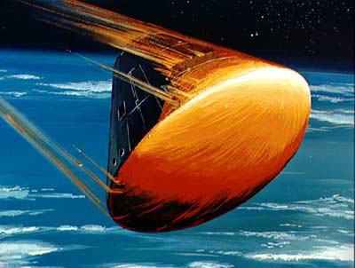
Apollo 11 Mission Part 3: Return to Earth
LM ascent stage puts the LM in lunar orbit
LM docks with Command Module
LM is jettisoned and left in lunar orbit
Service Module puts the spacecraft on trans-earth injection trajectory with a burn
Service module is jettisoned
Command Module enters atmosphere

Slide 19
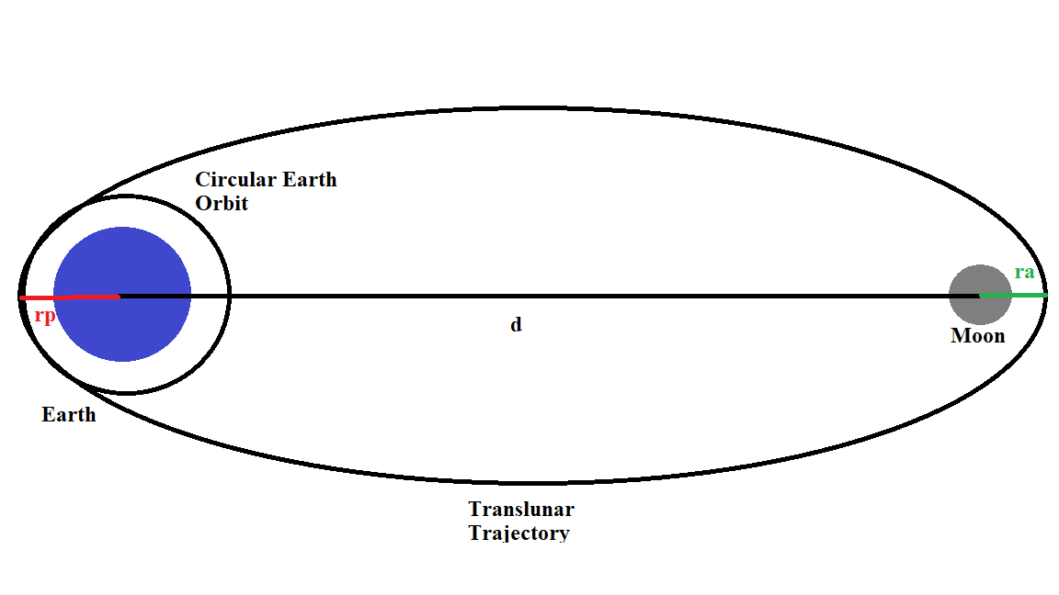
Apollo 11 Modelling
The modelling of the Apollo 11 mission will focus on the translunar injection maneuver.
The change in velocity will be calculated with both orbital mechanics and the rocket equation
Results will be compared to reported numbers
Translunar Injection:

Slide 20
Input Arguments
The following table shows reported numbers that will be used
Input | Value | Symbolic Representation
Altitude of Earth Orbit | 185,075 m
Altitude of Lunar Orbit | 106,619 m
Specific Impulse of J-2 | 421 s
Vacuum Thrust of J-2 | 1,033,100 N
Total Mass of Saturn V | 2,970,000 kg
Gross Mass of Stage 1 | 2,290,000 kg
Gross Mass of Stage 2 | 496,200 kg
Gross Mass of Stage 3 | 123,000 kg
Empty Mass of Stage 3 | 13,500 kg
Mass of Launch Escape | 3,631 kg

Slide 21
Important Values of R
The following are the values of r from the translunar injection figure:
Periapsis:
Apoapsis:
Distance to Moon:

Slide 22
Delta V Significance
For any change in orbit, there must be a change in kinetic energy
This is achieved through a burn
Change in velocity can be calculated from orbital Mechanics
Fuel burnt can be found using the Rocket equation

Slide 23
Earth Orbital Velocity
Newton’s Second Law:
Solve for the Velocity:
Reported Velocity: 7823 m/s

Slide 24
Translunar Velocity
Newton’s Second Law:
Solve for Velocity:
Reported Velocity: 10,952 m/s

Slide 25
Change in Velocity
From Classical Mechanics:
Reported Delta V: 3129 m/s

Slide 26
Inputs for Rocket Equation
Effective Exhaust Velocity:
Mass Flow Rate:

Slide 27
Calculate Burn Time to Check for Accuracy
Fuel Burned by Stage III:
Burn Time:
Reported Burn Time:
500 s

Slide 28
Mass Inputs for Rocket Equation
Initial Mass:
Final Mass:
Using the values from the table,

Slide 29
The Rocket Equation
Reported Delta V: 3129 m/s

Slide 30
Summarized Results
Calculated Quantity | Calculation | Reported Value | Error
Earth Orbital Speed | 7,791 m/s | 7,823 m/s | 0.41%
Translunar Injection Speed | 10,926 m/s | 10,952 m/s | 0.24%
Delta V (Orbital Mechanics) | 3,135 m/s | 3,129 m/s | 0.19%
Delta V (Rocket Equation) | 2,937 m/s | 3,129 m/s | 6.14%

Slide 31
Conclusion
As shown, basic modeling techniques can provide results within a relatively small region of error

